Slide 1
NAKUJA 4 SOLID PROPULSION TEAM
1
WEEK 8 PROGRESS REPORT

Slide 2
WEEK’S OBJECTIVES
1
2
To fabricate the parts that would be used in the curing under pressure process according to the CAD design and assemble the parts
To purchase the urgent equipment required to resume paused tasks
To continue with the fabrication of nozzle
To characterize the ignitor and produce a working model and documentation
To test and calibrate the pressure sensor
ESP32 Data Ingestion into UI dashboad

Slide 3
Purpose/Goal
3
To do a single grain static test to get pressure and burn rate exponents.
These values will be input in the open motor simulation to give us more accurate values for impulse, peak pressure and peak mass flux.
This will ultimately help us adjust the grains and other motor components in the 5 grain motor in preparation for a static test.

Slide 4
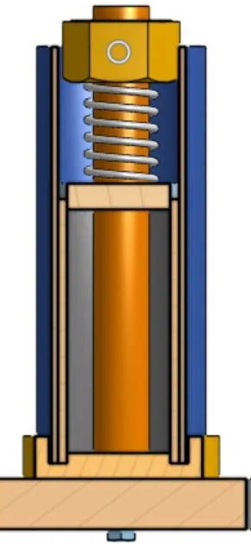
Fabrication of the curing under pressure parts
4
To achieve the objective of fabricating the parts required for the curing under pressure process as per the CAD design, various components were manufactured in-house, while others were sourced from external suppliers.
Parts | Method of acquisition
Bottom plate | 3D printed
Top plate | 3D printed
Core rod | Machined in the workshop
Liner | Used from the previous’ group
Casing | Fabricated in the fitting workshop
Bottom wooden base | Fabricated in the carpentry workshop
Nut | Purchased
Spring | Purchased
A photo showing the CAD
design of the mold assembly

Slide 5
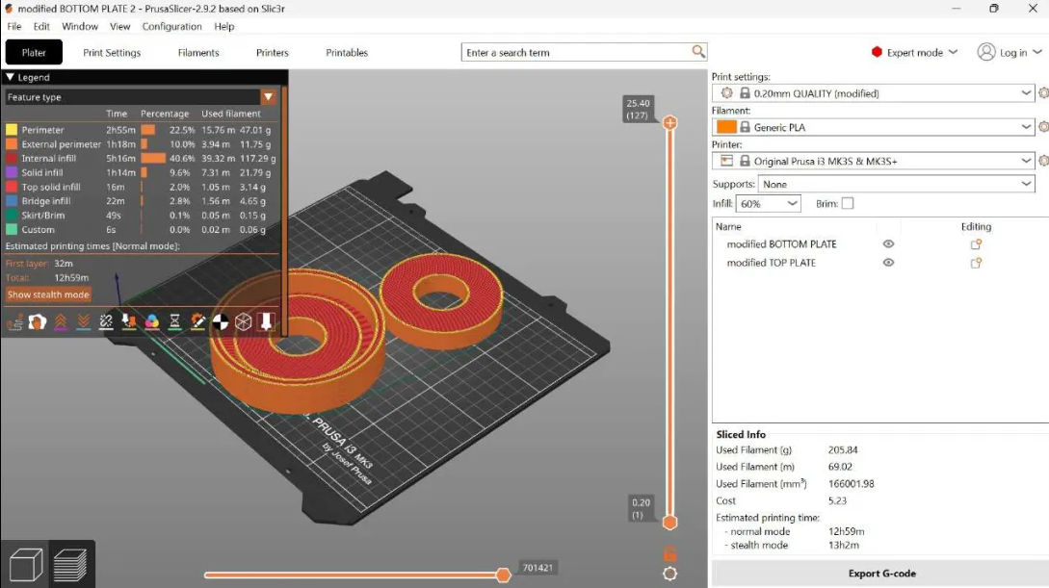
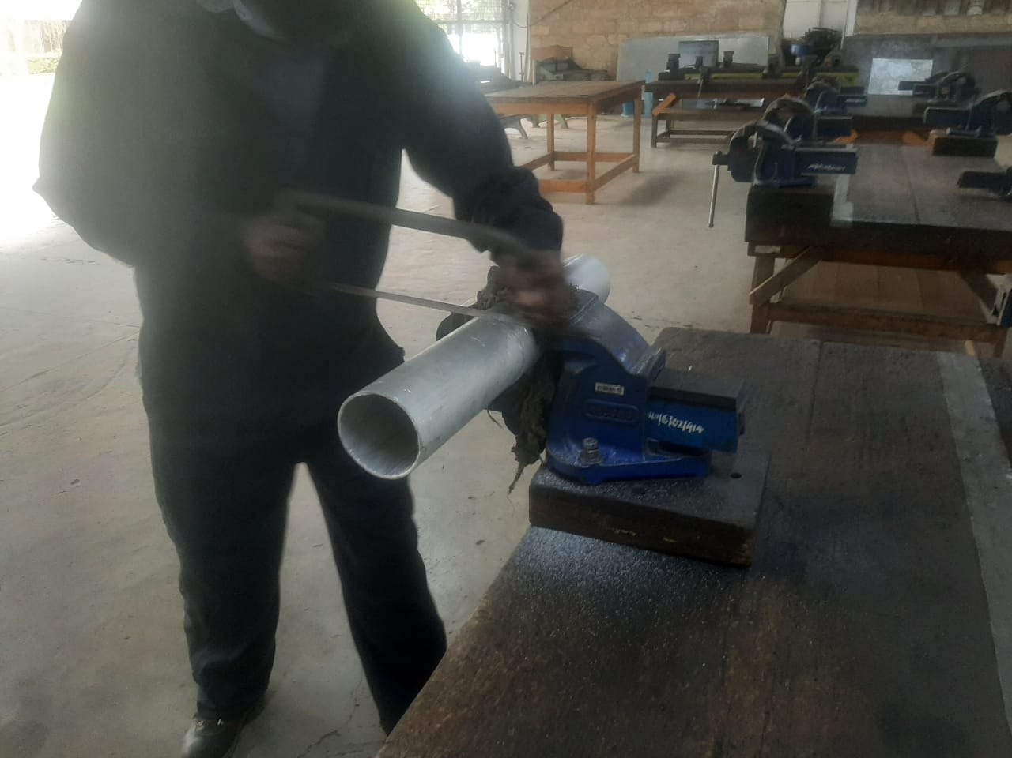
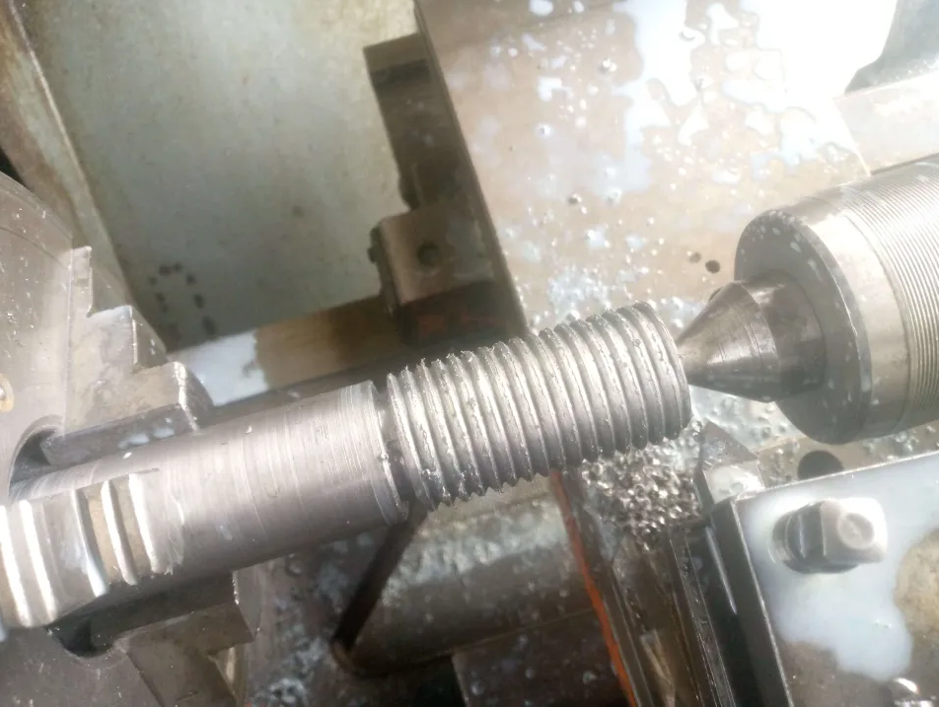
Fabrication of the curing under pressure parts
5
Preparation for 3D printing
Fabrication of the casing
Machining of the core rod

Slide 6
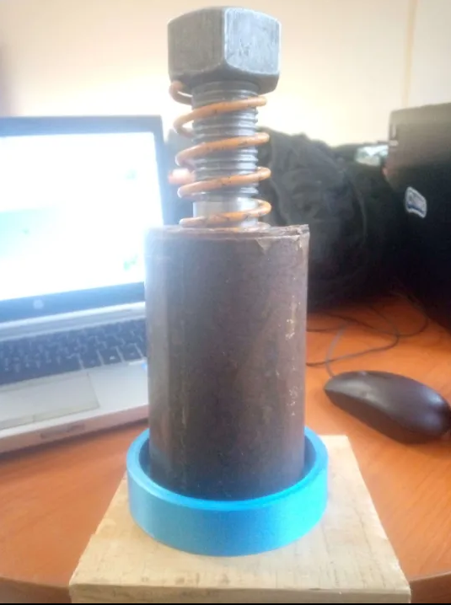
Assembly of the components
6
The parts were assembled according to the CAD design
A A photo showing the assembly of the fabricated
parts

Slide 7
Expected outcomes from the procedure
7
From the set up, the following are the expected results from Nakka’s rocketry site
Outcome | Effect on Grain Quality
Full void elimination | Uniform density and burn rate consistency
Near-ideal density | Higher specific impulse and predictable combustion
Intimate bonding to inhibitor | Stability during handling and use
Flat, even surfaces | Improved sealing and flow path control
Strong mechanical integrity | Better structural support in the motor chamber

Slide 8
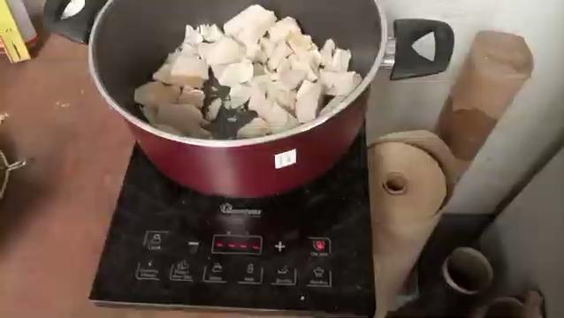
Challenge encountered
8
We were to test the procedure however we faced the most unforeseen situation.

Slide 9
Resumption of paused tasks
9
Some really important tasks were paused due to a shortage of equipment, but with the purchase of the required equipment, the tasks will resume immediately to achieve the intended goals
The table below shows how the depletion of products led to task interruptions and highlights the affected tasks
Depletion of equipment/material | Task that had been affected
Epoxy | Fabrication of the mandrel
Mild steel | Fabrication of the nozzle and core rods
Aluminium | Fabrication of more bulkheads

Slide 10
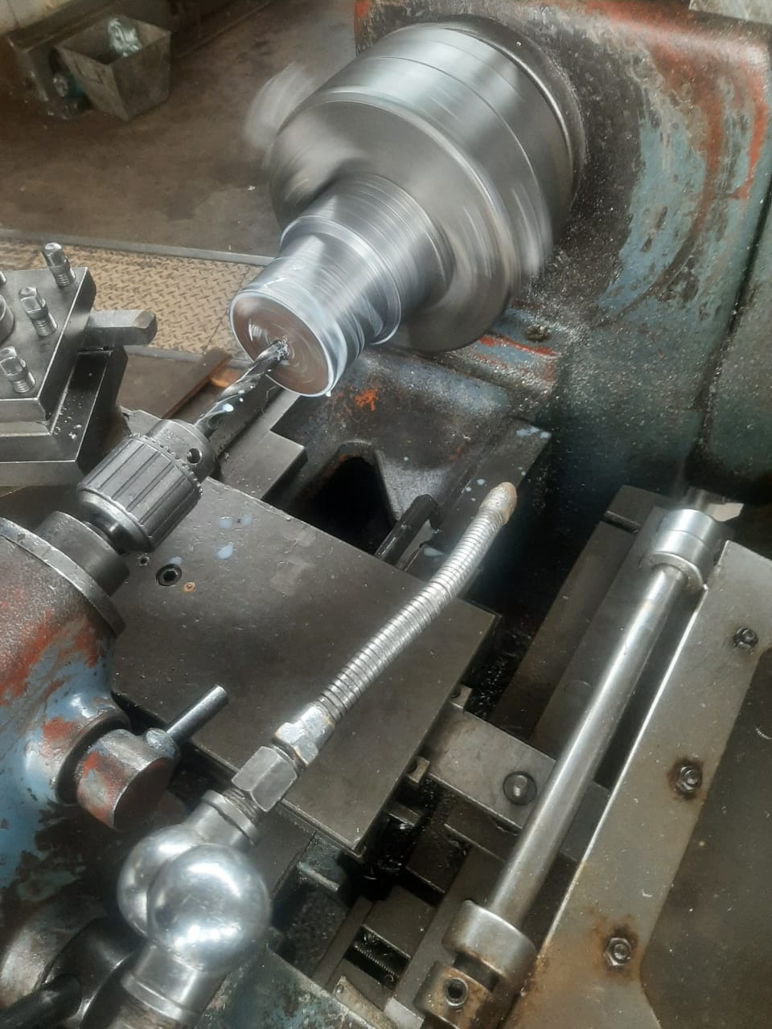
Fabrication of the nozzles
10
The fabrication of the nozzle is ongoing
A photo showing process of machining of the nozzle

Slide 11
Availability of lathe machine
11
Machining has been challenging due to the ongoing internal attachment of second-year students, restricting access to the lathe machines to only Thursdays and Fridays. This limited time is insufficient for machining the core rods, nozzle, and bulkheads
Recommendation
We request that the administrators allocate one lathe machine for our use, since there are several functional lathes, especially during the period when students on internal attachment are in the machine shop, to allow us to carry out machining from Monday to Friday until the fabrication of the machined parts is completed, ensuring consistency

Slide 12
Characterization of the Ignitor
12
We realized that there wasn’t proper documentation on the ignitor we use that shall inform the redesign and future improvement of the ignition system, as well as prevent ignition delay
A proposed casting tool is to be designed for the ignitor for the size reduction (from 211.84 g to 25.00 g).
Thermochemical modelling and analysis will be the key part of the documentation of the ignitor.

Slide 13
13
Cont…
The framework for this study that will be as follows:
1.Description of the ignition characteristics:
a)Auto-ignition temperature (AIT)
b)Ignition delay time
2.Reaction kinetics:
a)Rate of gas evolution: informs magnitude of shockwave
b)Rate of heat release (Q ̇)
c)Energy barriers or Activation energy (E_a)

Slide 14
14
Cont…
3.Thermodynamic properties:
a)Adiabatic flame temperature
b)Specific Impulse (I_sp)
c)Pressure-time profile
4.Sensitivity and safety metrics:
a)Impact and friction sensitivity
b)Thermal stability (T_so)
5.Microstructure and defect analysis: reactant clustering, voids and hotspots, particle contact quality

Slide 15



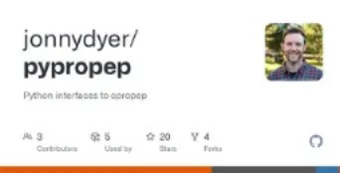

Toolset for this study
15
This will be done through Molecular Dynamics simulations

Slide 16
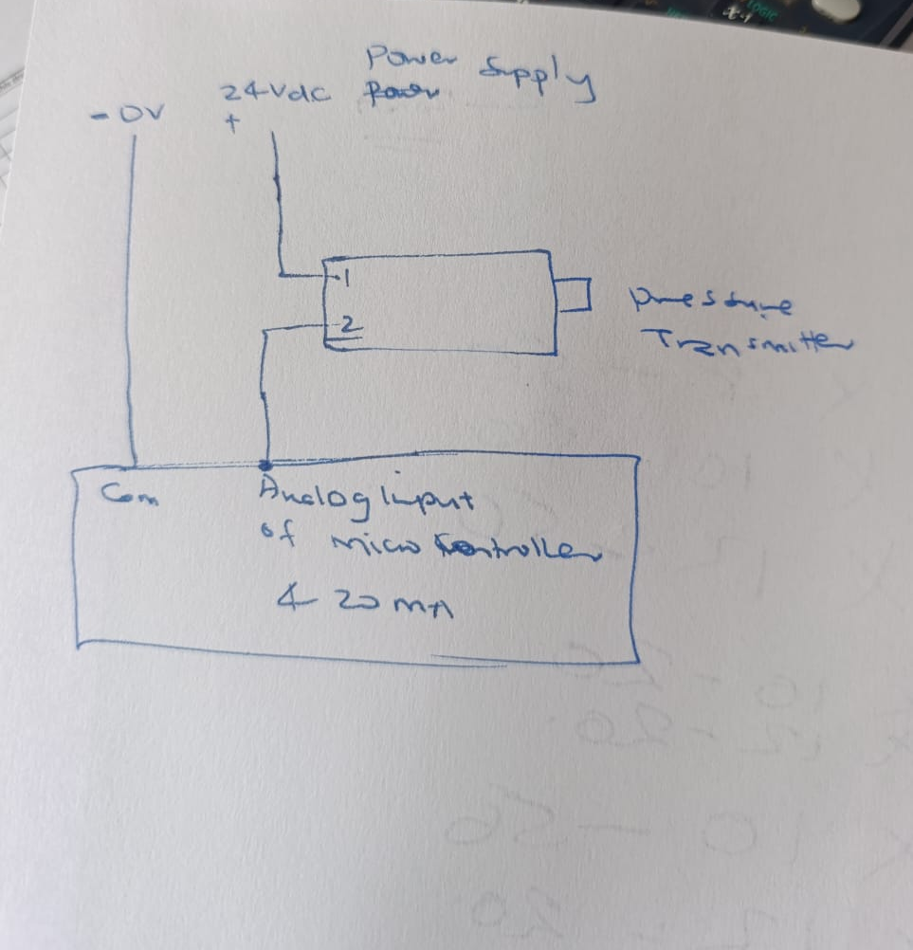
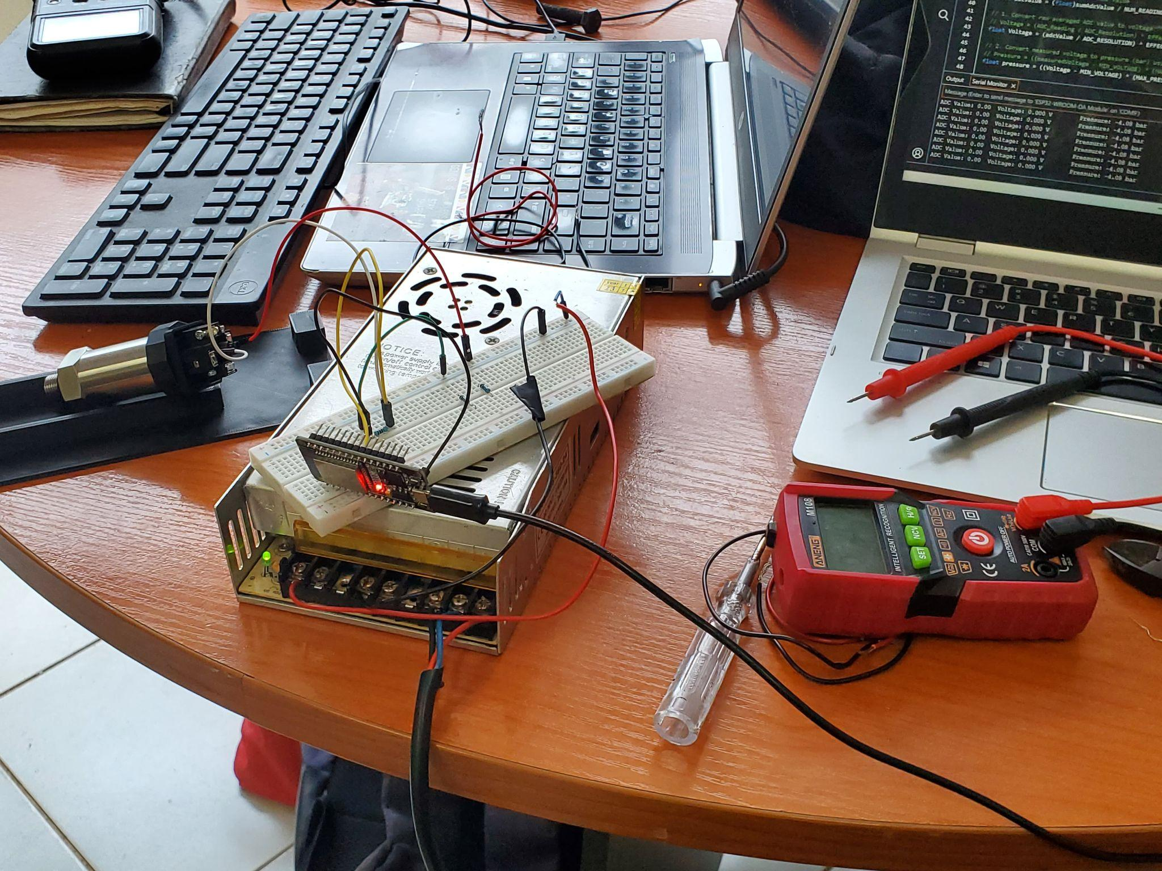
Testing and calibration of the pressure sensor
16
2- Wire Pressure Transmitter Output loop

Slide 17
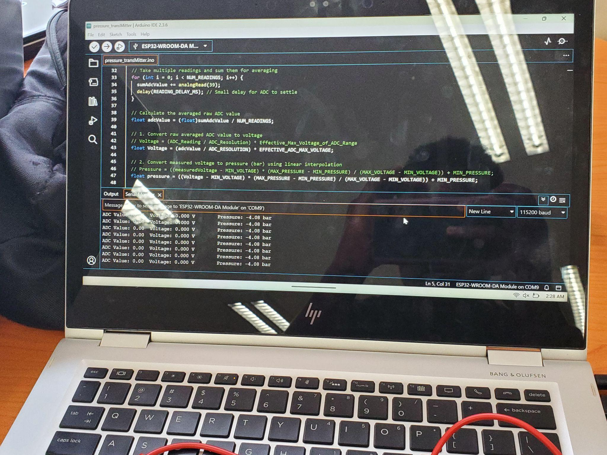
Cont…
17
RESULTS
The output result was zero with both 15V supply and 24V supply.
Troubleshooting:We tried measuring the output current using a multimeter but no current was registered(Ideally should be 4mA at 0 pressure)
We contacted the supplier and after justifying and providing the test and justifying they agreed we can take the transmitter to them for further testing. This can be done probably next week.

Slide 18
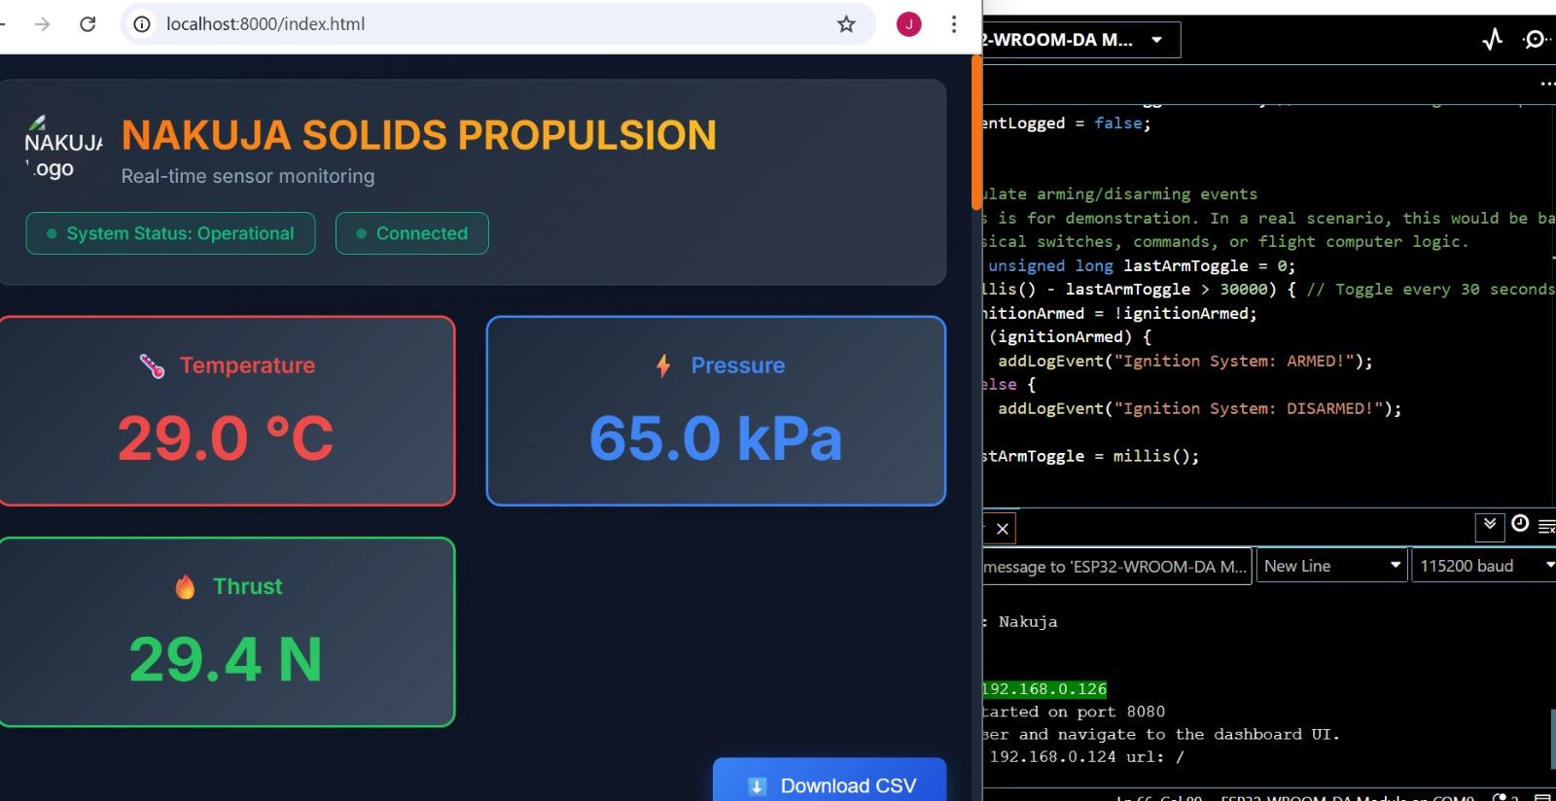
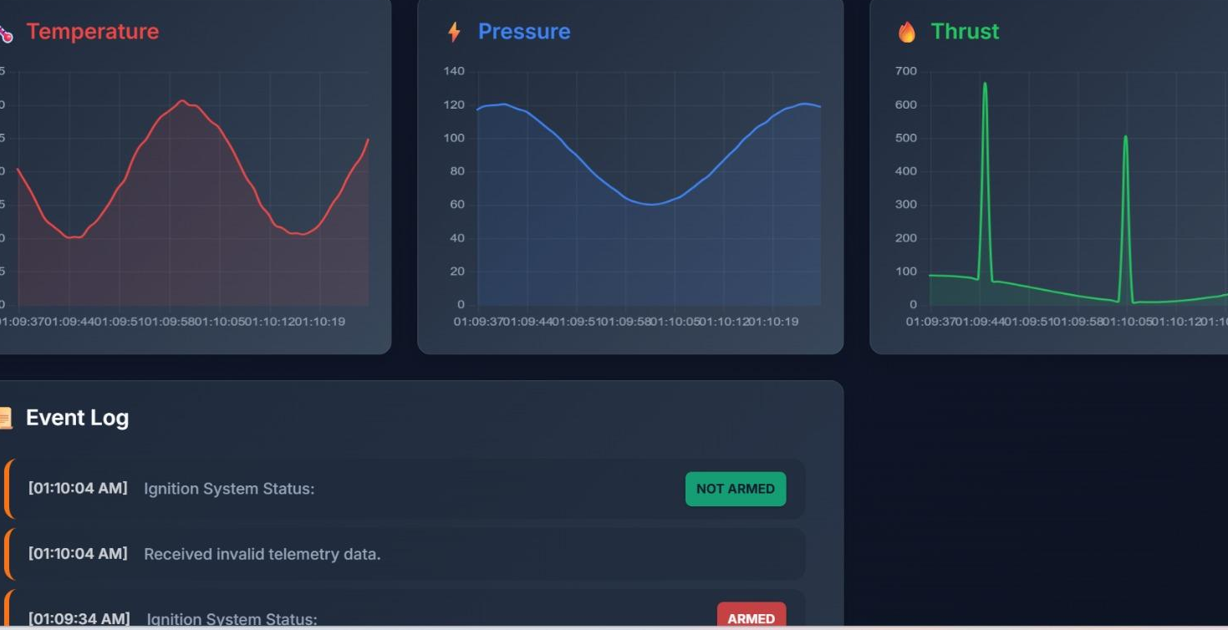
ESP32 Data Ingestion into UI dashboad
17
ESp32 Communicates with the Dashboard using WedSockets for communication protocol

Slide 19
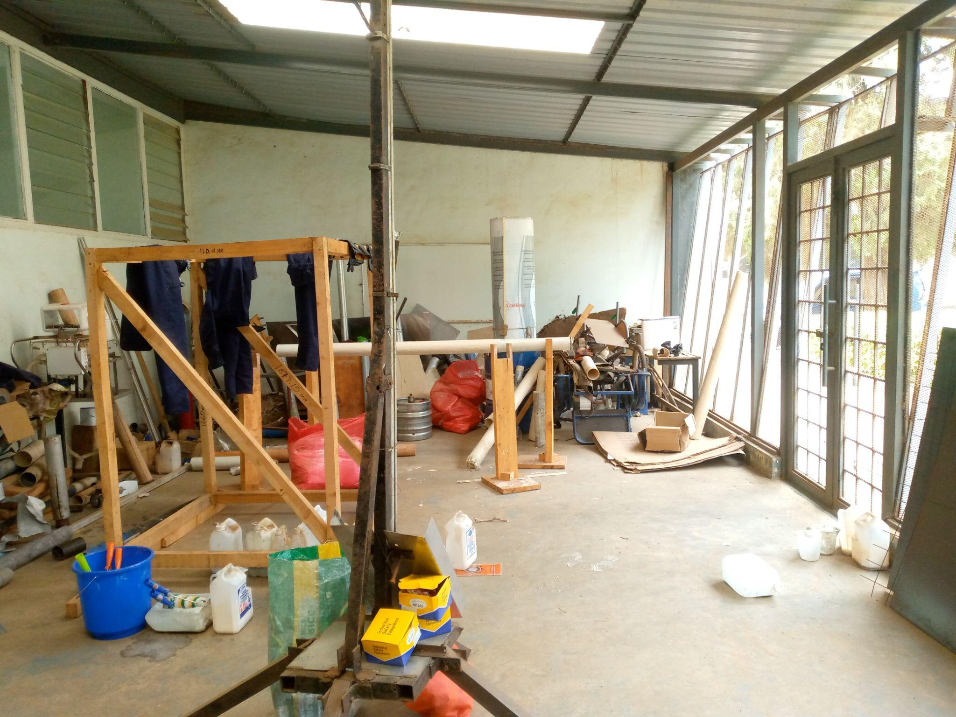
Housekeeping
18
An inter-team task force is to be formed to organize and catalogue the items in the Rapid Lab and Exhibition Area.
An Inventory management system is currently in the works and is yet to be deployed.
A photo showing the Exhibition Area

Slide 20
NEXT WEEK’S OBJECTIVES
20
Fabrication of the liner
Testing of curing under pressure
Preparation of the machine shop materials in preparation of fabrication
Assembly of the test motor
Modification of the motor holder

Slide 21
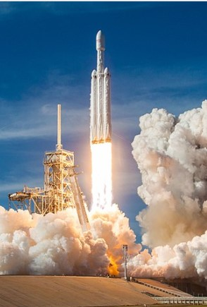
Thank you
21

